Slide 1
Getting Started With Reproducible Neuroimaging Analyses
TRINITY COLLEGE DUBLIN
Jivesh Ramduny

Slide 2
What does Reproducibility mean?
The term reproducibility refers to the ability of obtaining the same results of a prior study using closely matched procedures as described by the original research (Goodman et al., 2016).

Slide 3
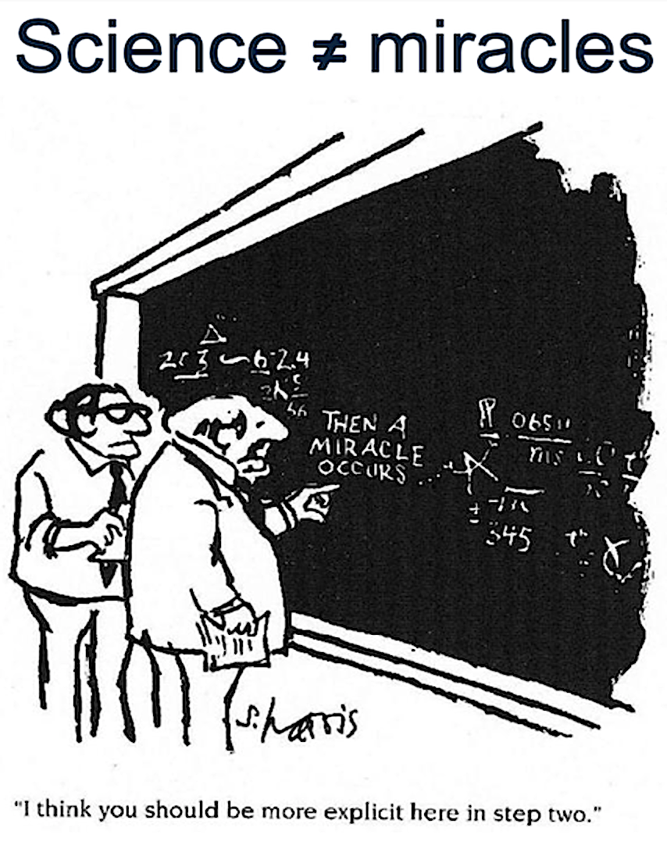
Why do we have a Reproducibility Crisis in Research?

Slide 4
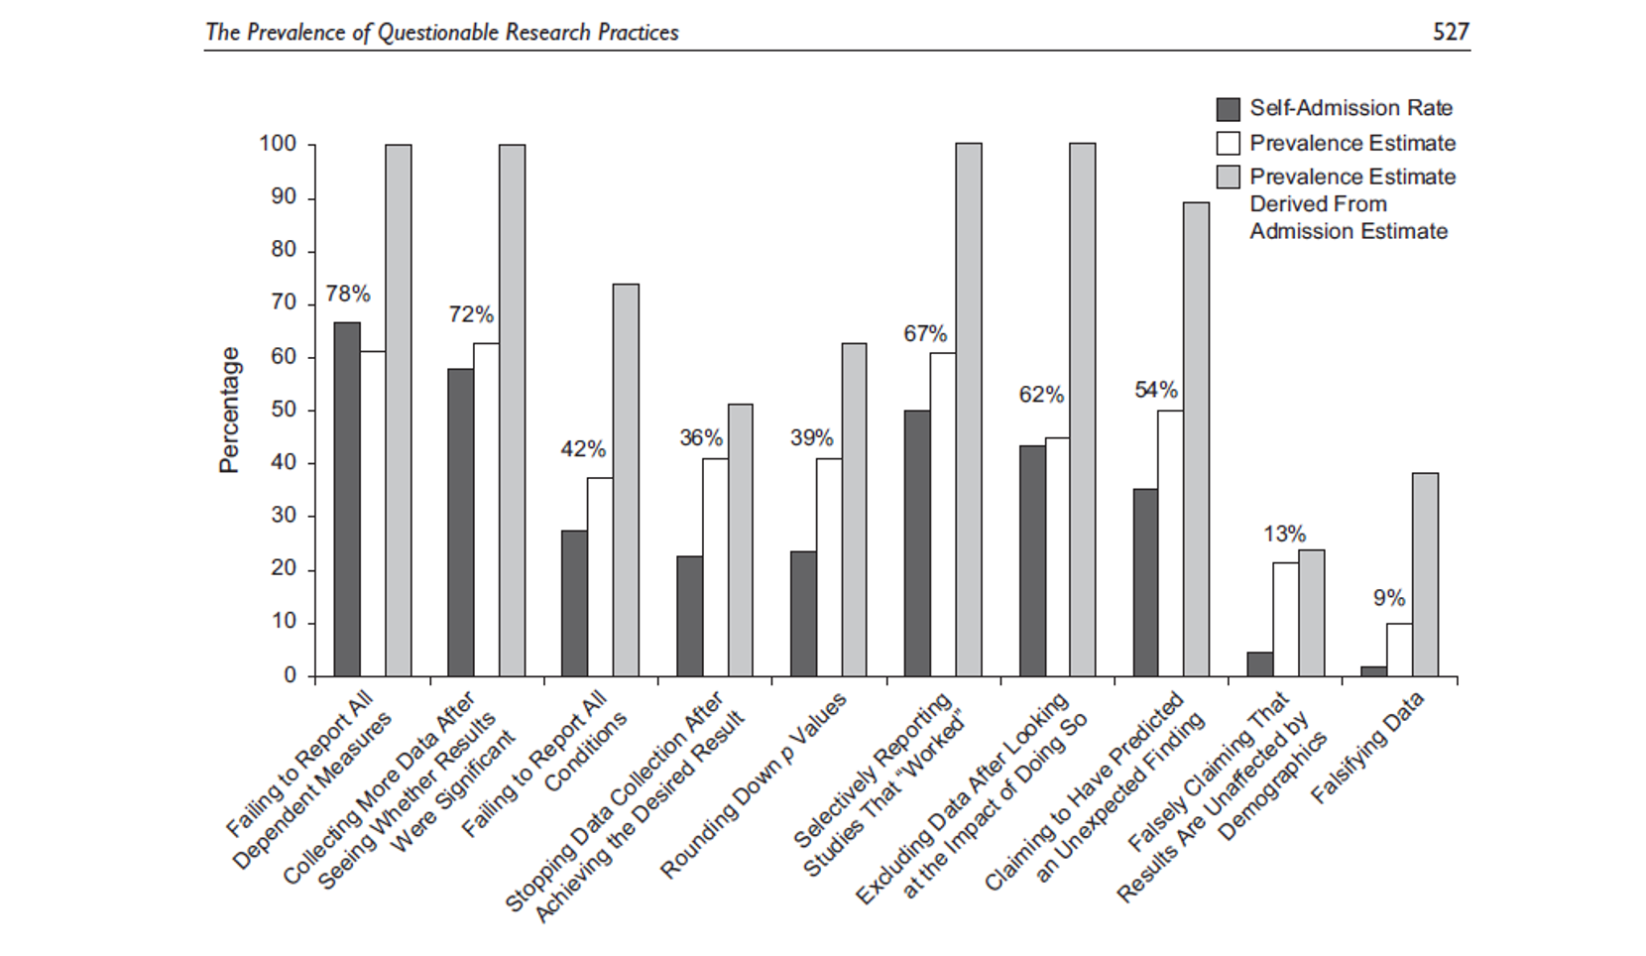
Courtesy of Prof Bishop
Adapted from John et al., 2012

Slide 5
Hypothesis Driven Method
Publish or conduct next experiment
Generate and specify hypotheses
Publication bias
Failure to control for bias
HARKing
Interpret data
Design study
p-hacking
Low statistical power
Analyse data & test hypotheses
p-hacking
Collect data
Courtesy of Prof Bishop
Adapted from Munafò et al., 2017
Poor quality control

Slide 6
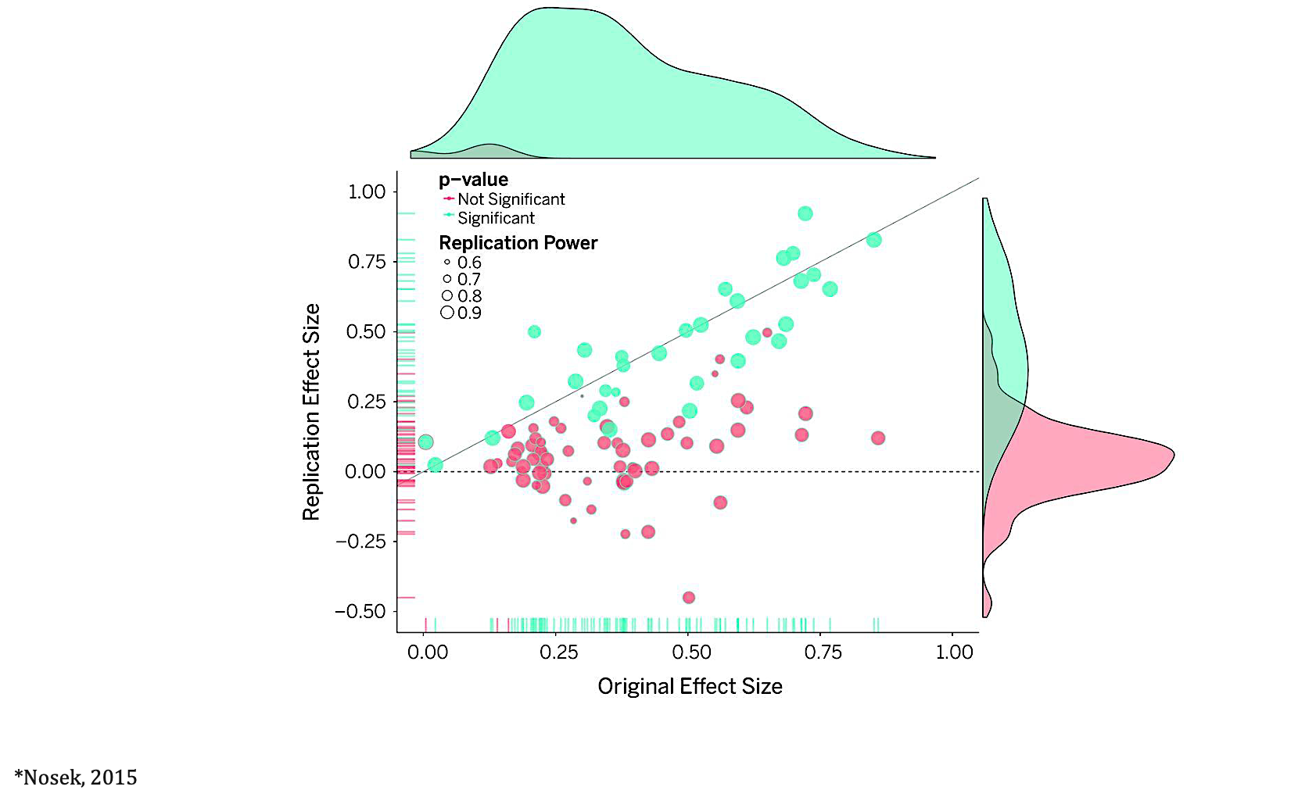
Adapted from Nosek, 2015
100 experimental and correlational studies published in three psychology journals
36% of replications had significant results.
39% of effects were subjectively rated to have replicated the original result.
47% of the original effect sizes were in the 95% CI of the replication effect size.

Slide 7


Test-Retest Reliability of the Functional Connectome
Consistency of a measure to yield same results under a number of plausible scenarios
Intraclass correlation coefficient (ICC)
ICC is a measure of statistical stability between two measurements, e.g. fMRI acquisitions.
ICC is computed as the ratio of between-subject variance to within-subject variance.
Poor
ICC < 0.2
Fair
0.2 < ICC < 0.39
High
0.6 < ICC < 0.79
Moderate
0.4 < ICC < 0.59
Excellent
ICC > 0.8
$↓$ Reliable
$↑$Reliable
Andellini et al., 2015

Slide 8
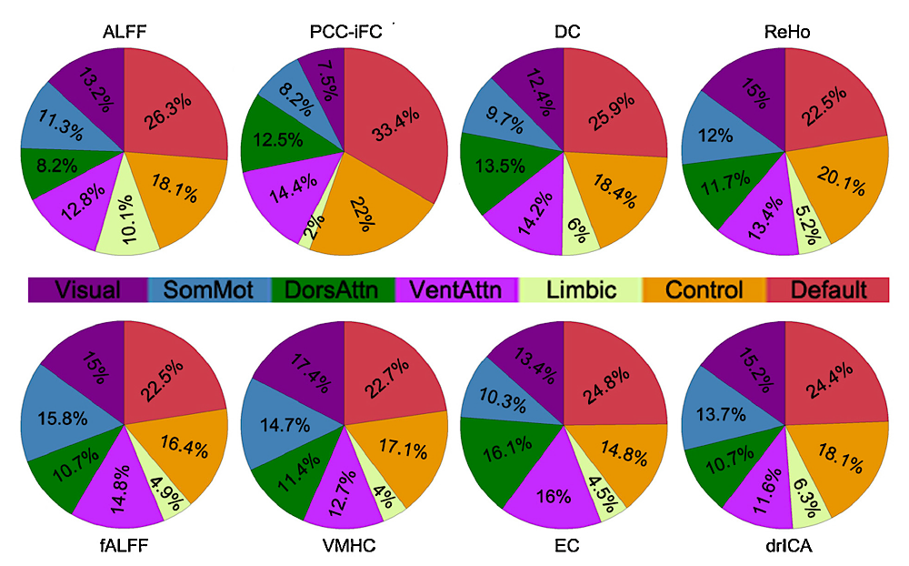
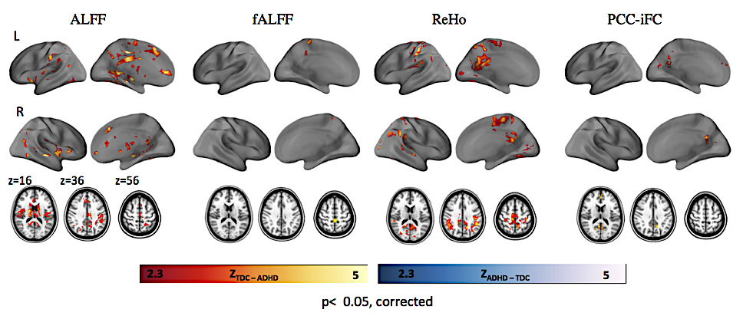
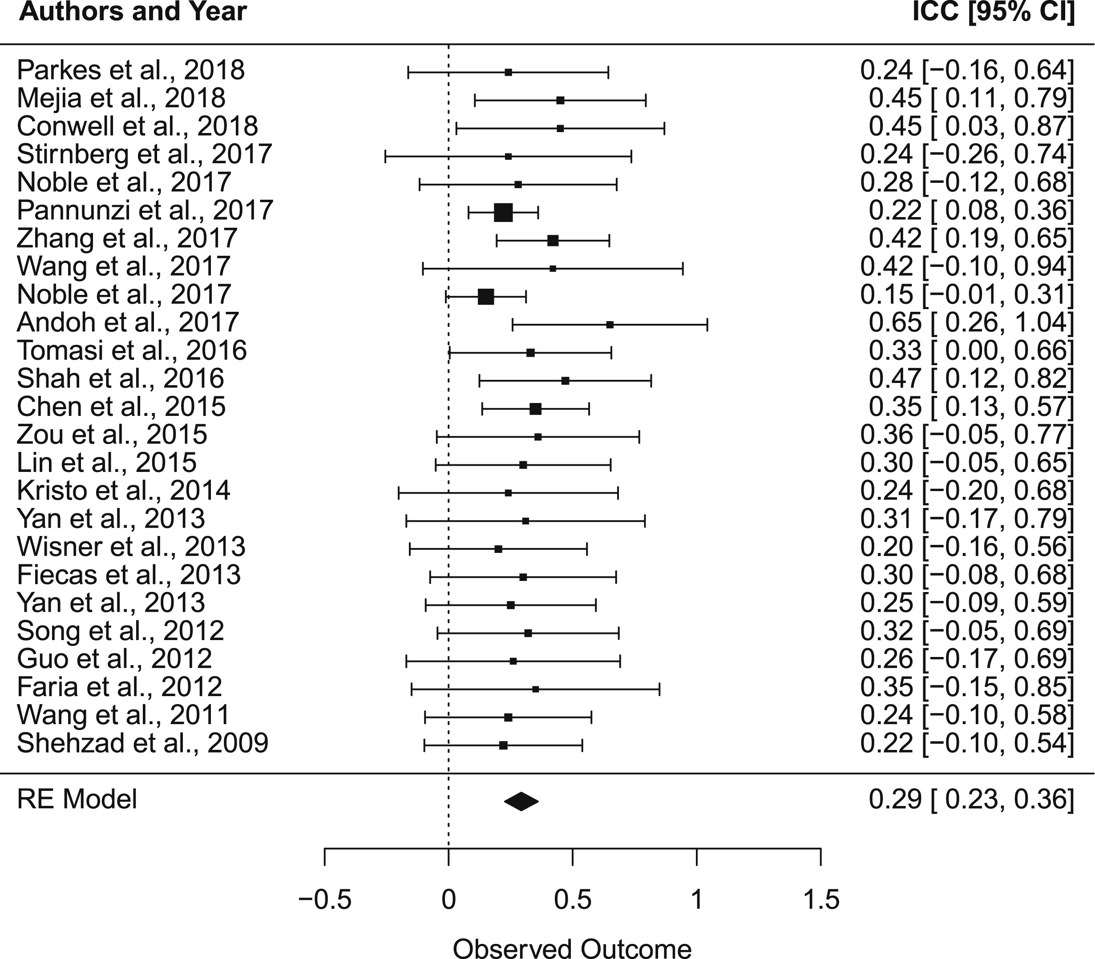
Reliability of the Functional Connectome Across Lifespan
Adapted from Zuo et al., 2014
Adapted from Somandepalli et al., 2015
Reliability ranges from poor to moderate in the literature.
Adapted from Noble et al., 2019

Slide 9
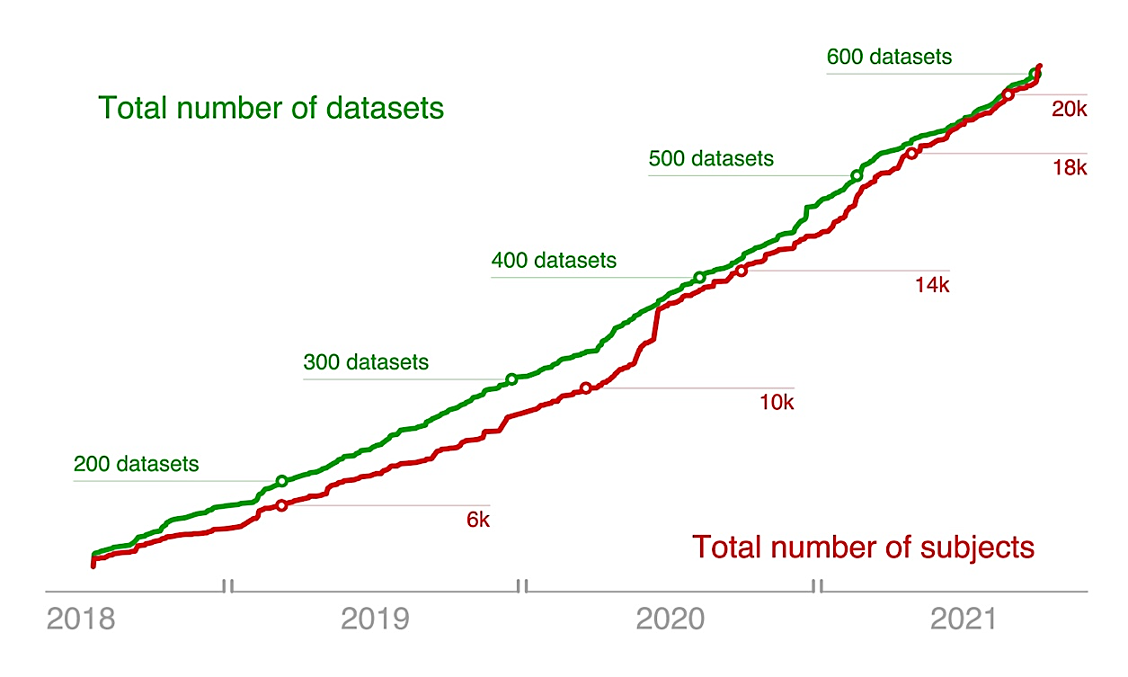
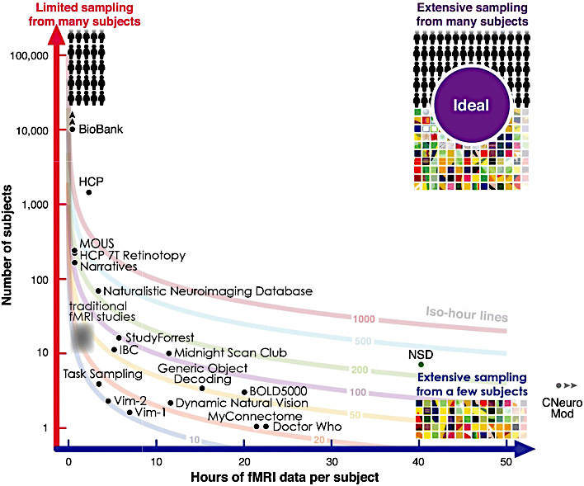
Data Sharing
OpenNeuro (https://openneuro.org)
604 datasets derived from MRI modalities:
Structural MRI, n = 501
Diffusion MRI, n = 53
Functional MRI, n = 445
Adapted from Markiewicz et al., 2021
Open Access Large Datasets
UK Biobank
Healthy Brain Network (HBN)
Human Connectome Project (HCP)
Naturalistic Neuroimaging Database (NND)
1000 Functional Connectome Project (FCP)
Autism Brain Imaging Data Exchange (ABIDE)
Adolescent Brain Cognitive Development (ABCD)
Consortium for Replicability and Reproducibility (CoRR)
Adapted from Madan, 2021

Slide 10
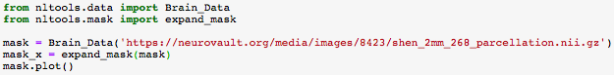
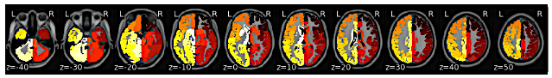
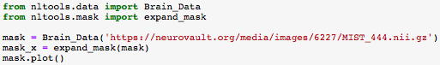
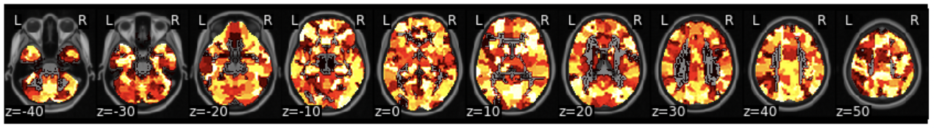
Brain parcellations, statistical maps and atlases
Neurovault

Slide 11
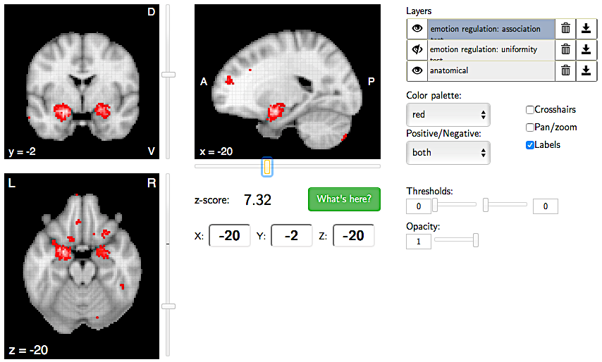
Brain parcellations, statistical maps and atlases
NeuroSynth
Term-based Query: “emotional regulation”.
247 studies corresponding to the term “emotion regulation”.
10 ROIs corresponding to the bilateral amygdala, bilateral dorsolateral prefrontal cortex, left dorsal premotor cortex, left ventrolateral prefrontal cortex, left rostral anterior cingulate cortex, left ventrolateral prefrontal cortex, left rostral anterior cingulate cortex, left anterior insula, right orbitofrontal cortex and right anterior prefrontal cortex.

Slide 12
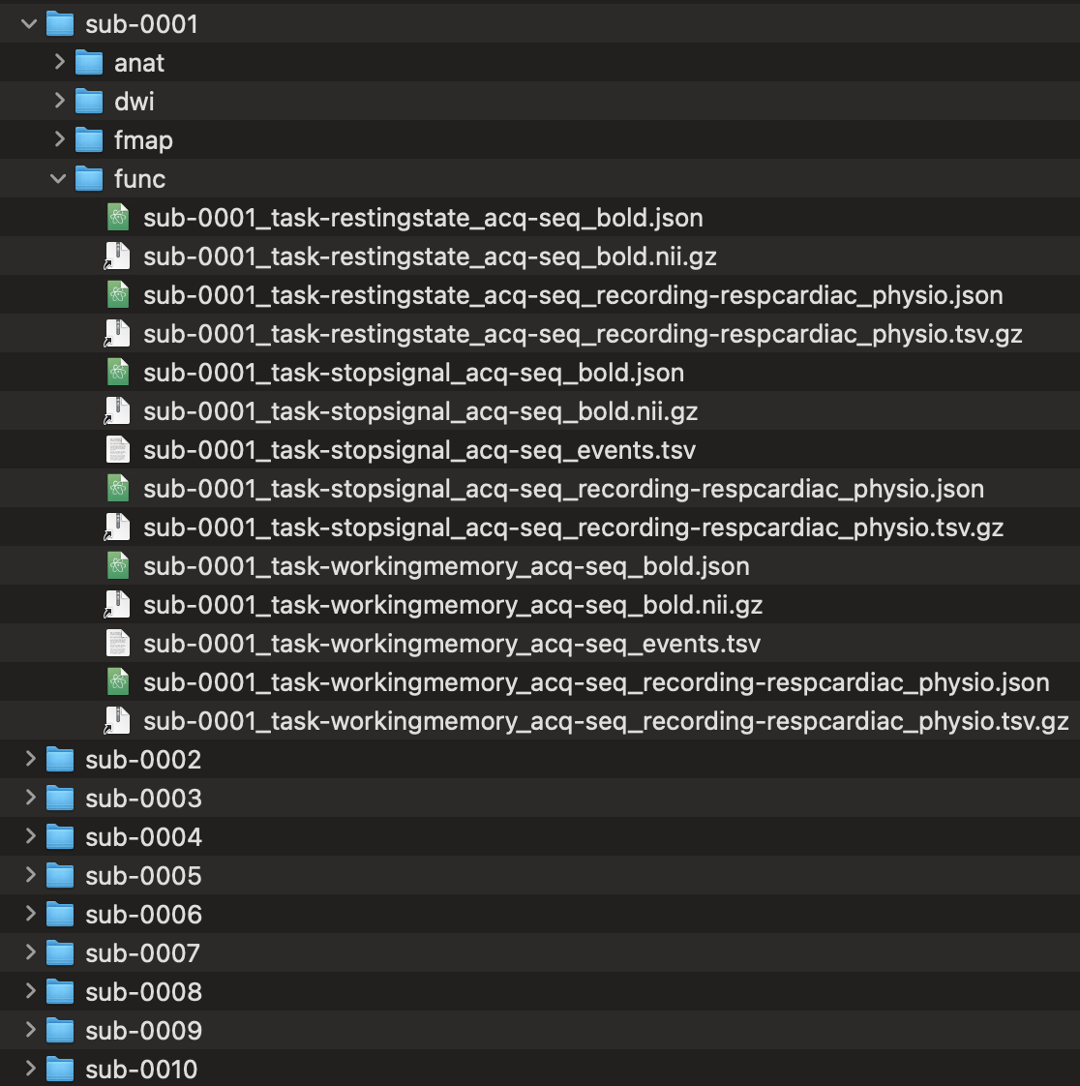
Brain Imaging Data Structure (BIDS)
Why does the neuroimaging community use BIDS?
It is a lot easier for other researchers to work on your data.
A growing number of data analysis software packages use the BIDS format as input.
Hosting platforms of Open Access datasets are increasingly organised in BIDS format (e.g., OpenNeuro, LORIS, COINS, XNAT).
https://bids.neuroimaging.io/index.html

Slide 13
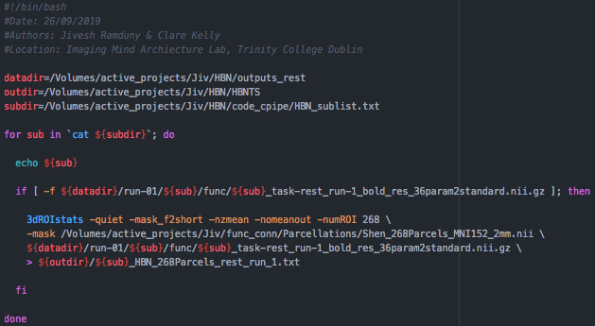
Brain Imaging Data Structure (BIDS)
e.g., extracting resting-state fMRI timeseries

Slide 14
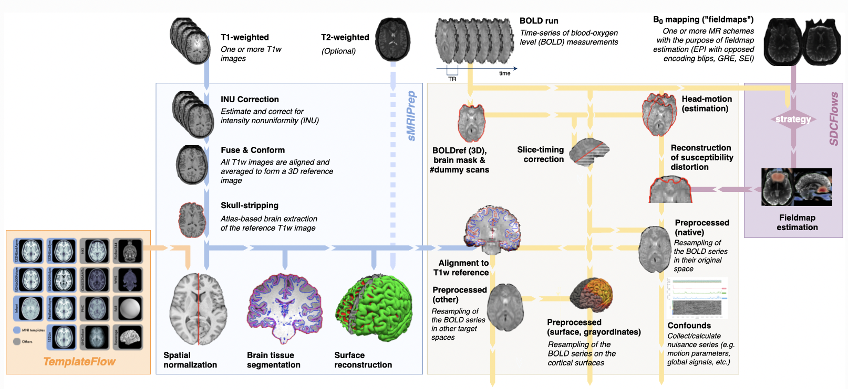
Preprocessing Pipelines
fMRIPrep, NiPreps, C-PAC
fMRIPrep offers a minimal preprocessing pipeline for resting-state and task-based fMRI. It is easily accessible and robust to variations in scan acquisition protocols and requires minimal user input (https://fmriprep.org/en/stable/).

Slide 15
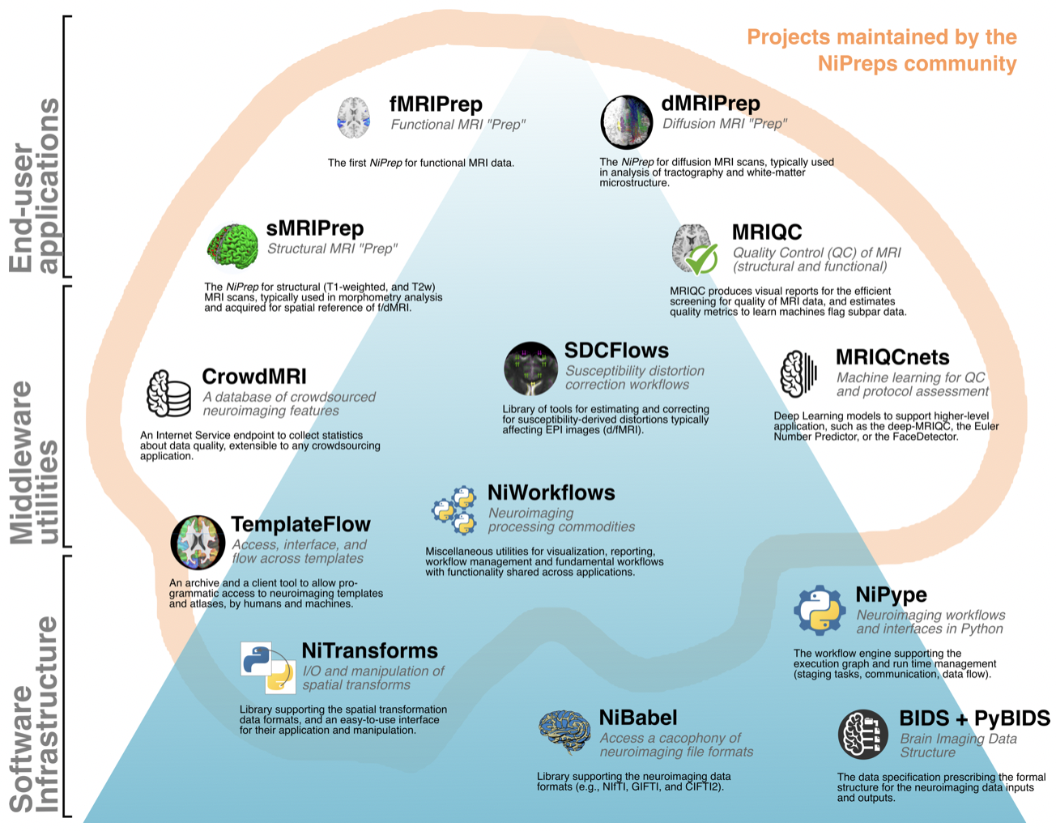
Preprocessing Pipelines
fMRIPrep, NiPreps, C-PAC
NiPreps augment the scanner to produce data directly consumable by analyses (https://www.nipreps.org).

Slide 16
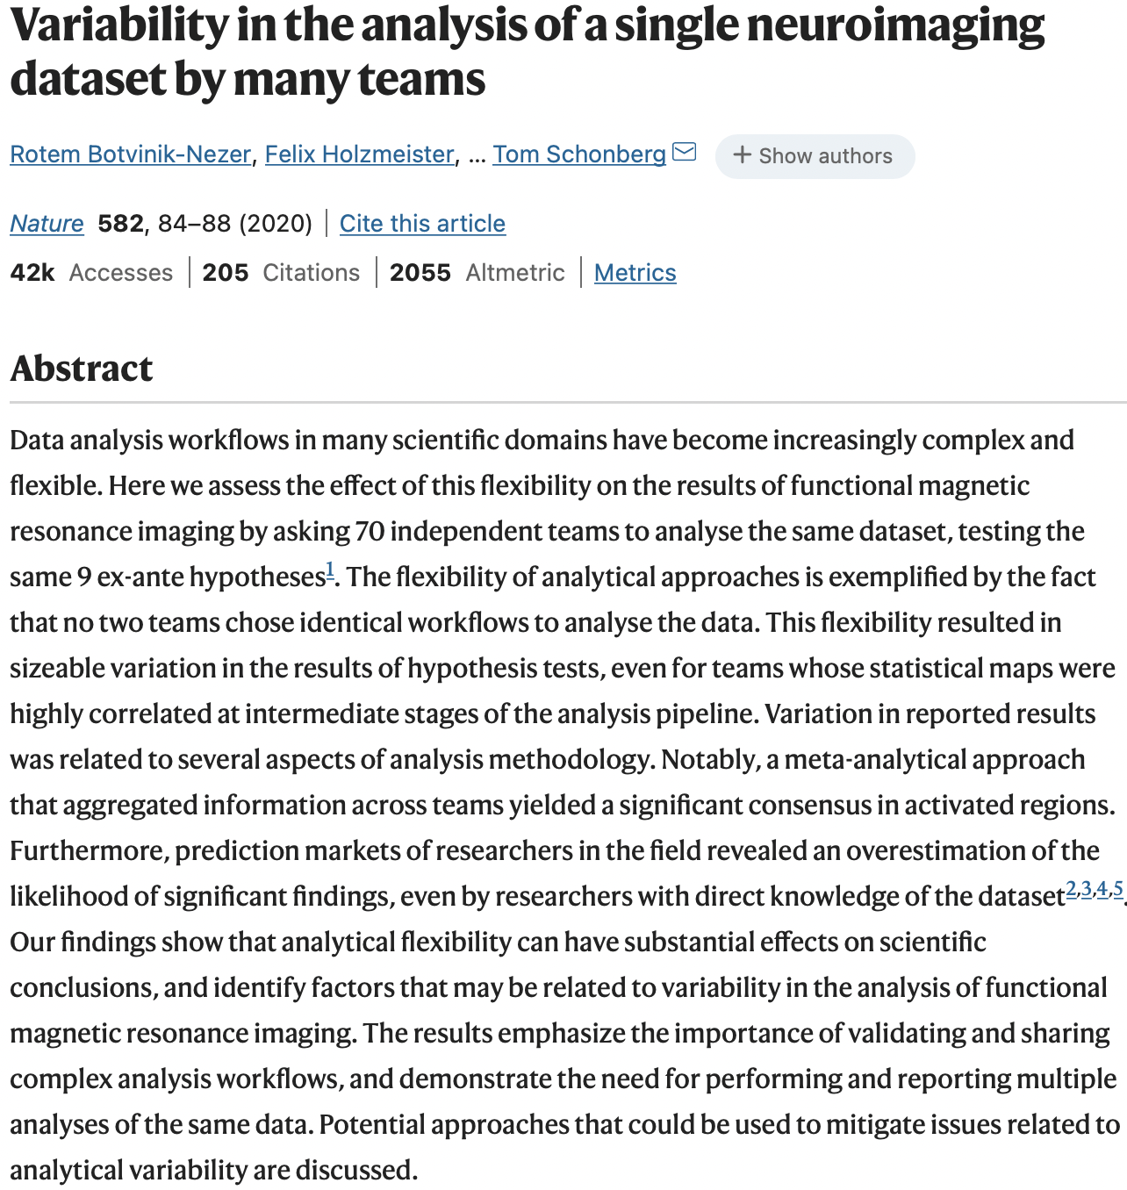
Preprocessing Pipelines
70 independent teams across the world analysed a single dataset (NARPS, n = 108) to test nine hypotheses (Botvinik-Nezer et al., 2020).
No two teams applied similar pre- and post-processing pipelines. Variability in the results attributed to the following:
spatial smoothing
analysis software
methods for multiple comparisons
thresholds for statistical maps

Slide 17
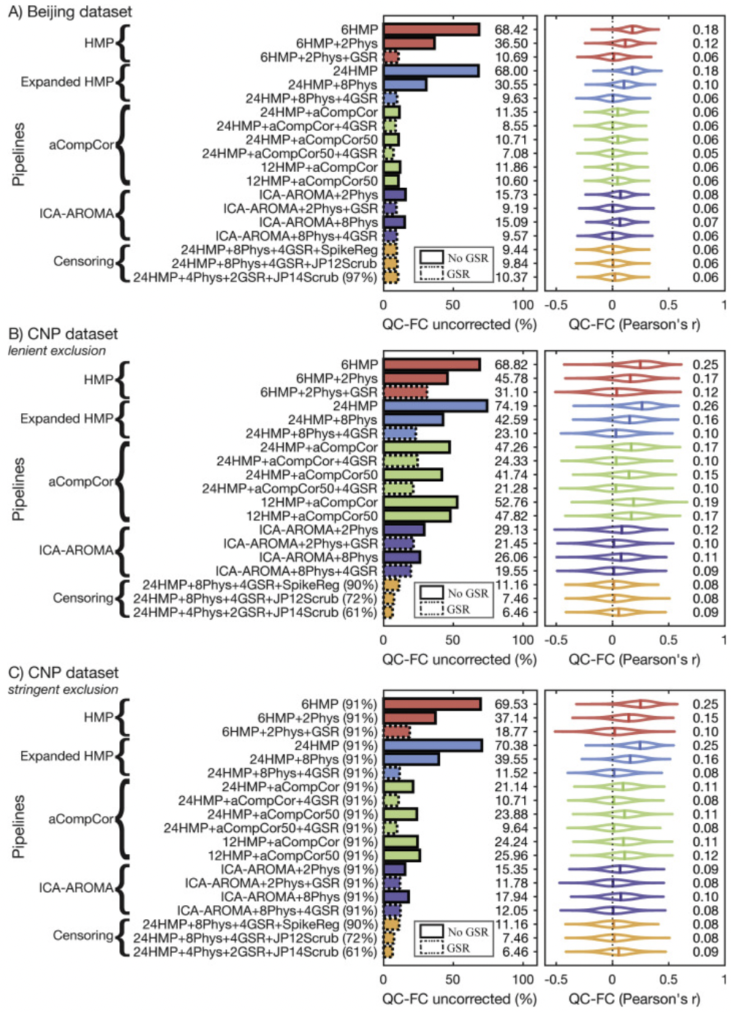
Challenges: Preprocessing Pipelines
There is not a SINGLE preprocessing pipeline that could perform consistently well across all the datasets in the world.
To say that there is only one way to preprocess your raw neuroimaging data is probably wrong as there are numerous way that this procedure can be achieved.
Adapted from Parkes et al., 2018

Slide 18
Preprocessing Pipelines
Important considerations for your analyses
Should I apply Global Signal Regression as a nuisance regressor?
What is the optimal smoothing kernel for my dataset?
What is the ideal motion correction strategy for my dataset?
How should I treat high-motion participants in my analyses?
What parcellation scheme should I use to extract the fMRI timeseries?
What are the covariates to include in my model during data analysis?
What multiple comparison correction should I apply?
Should I perform parametric or non-parametric statistical tests?
Should I worry about which software versions I use for my analyses?

Slide 19
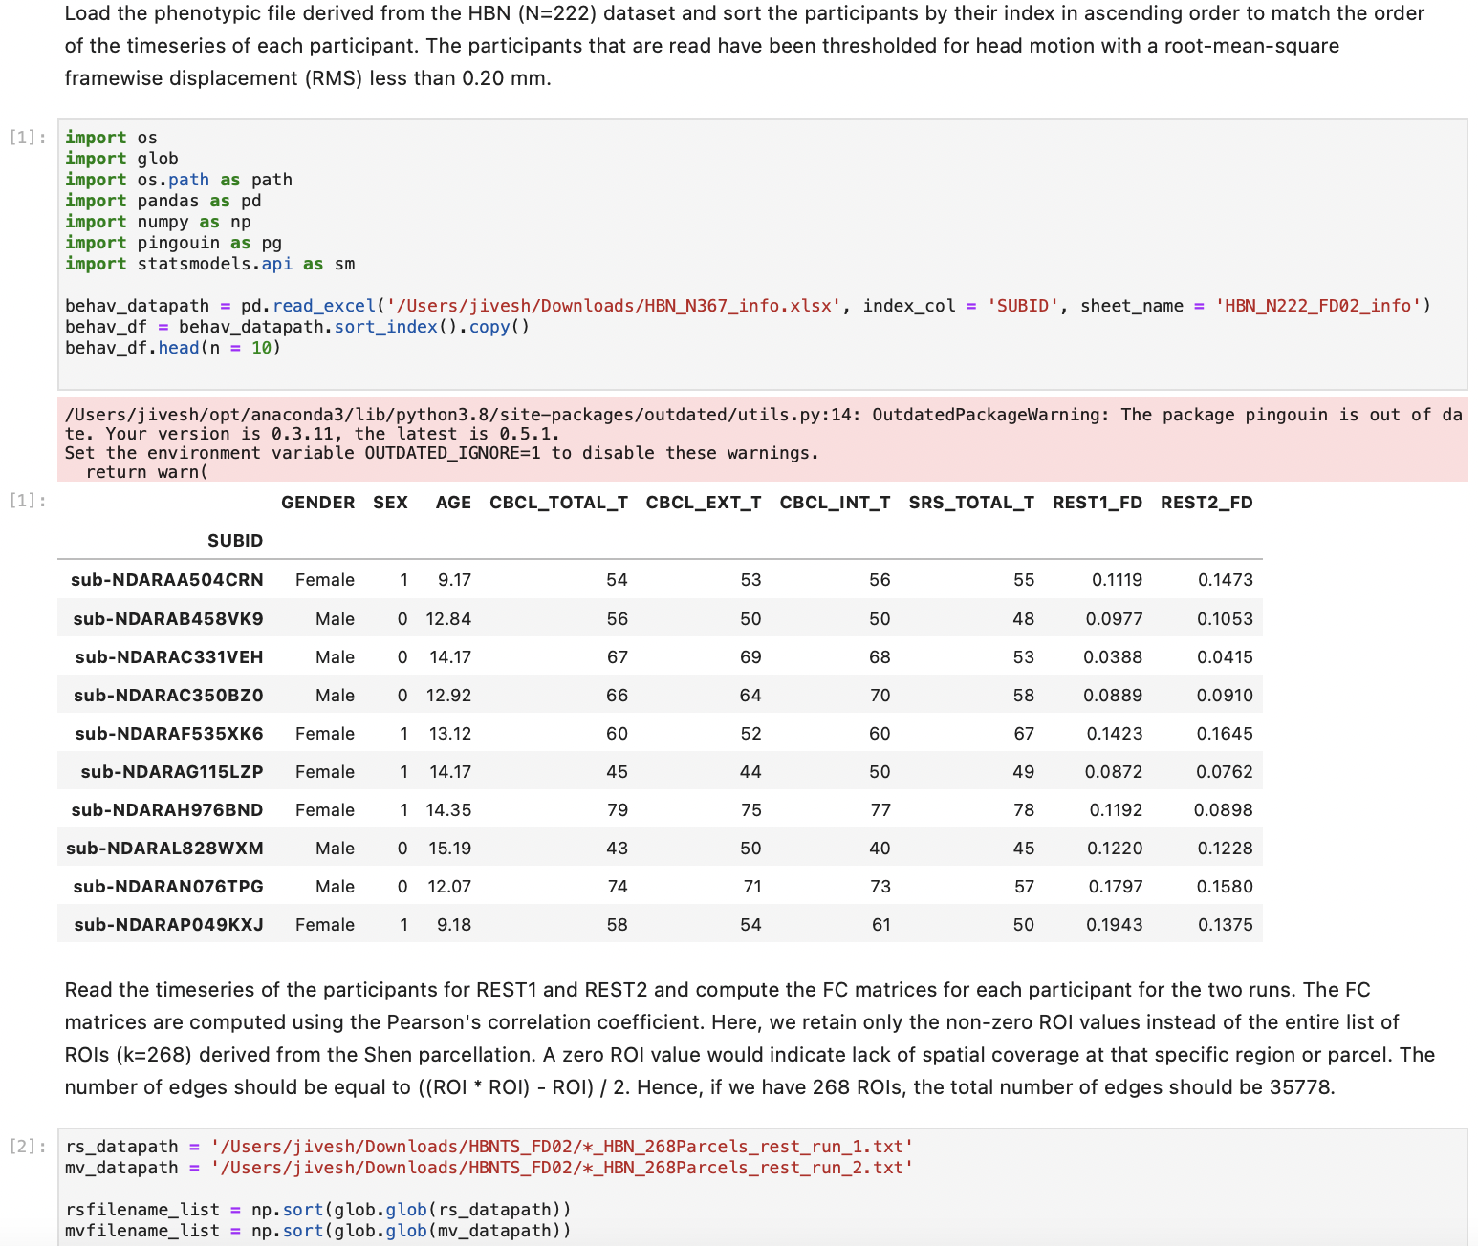
Python Notebooks: Jupyter Notebook

Slide 20
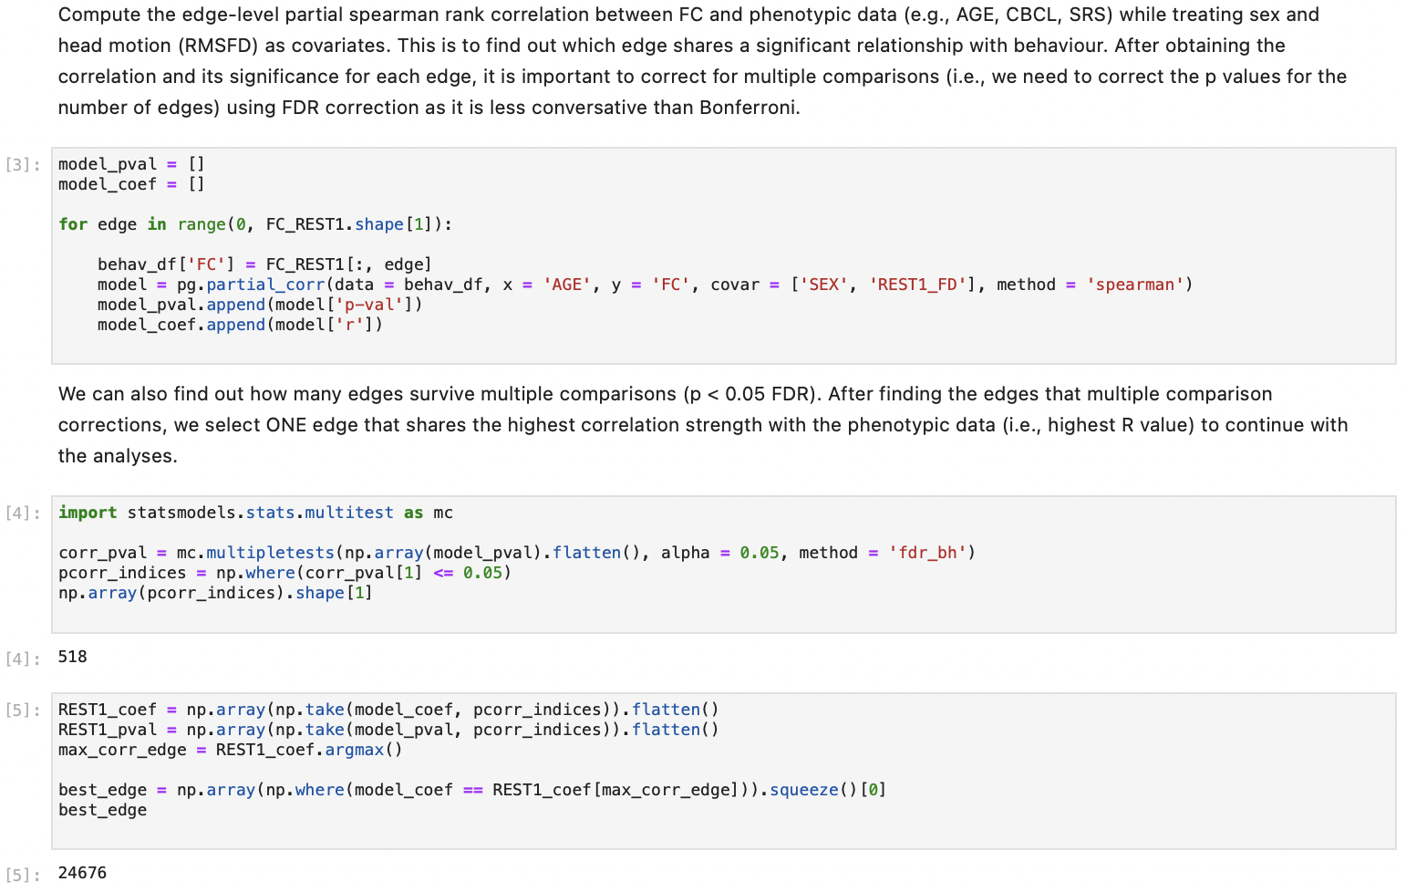
Python Notebooks: Jupyter Notebook

Slide 21
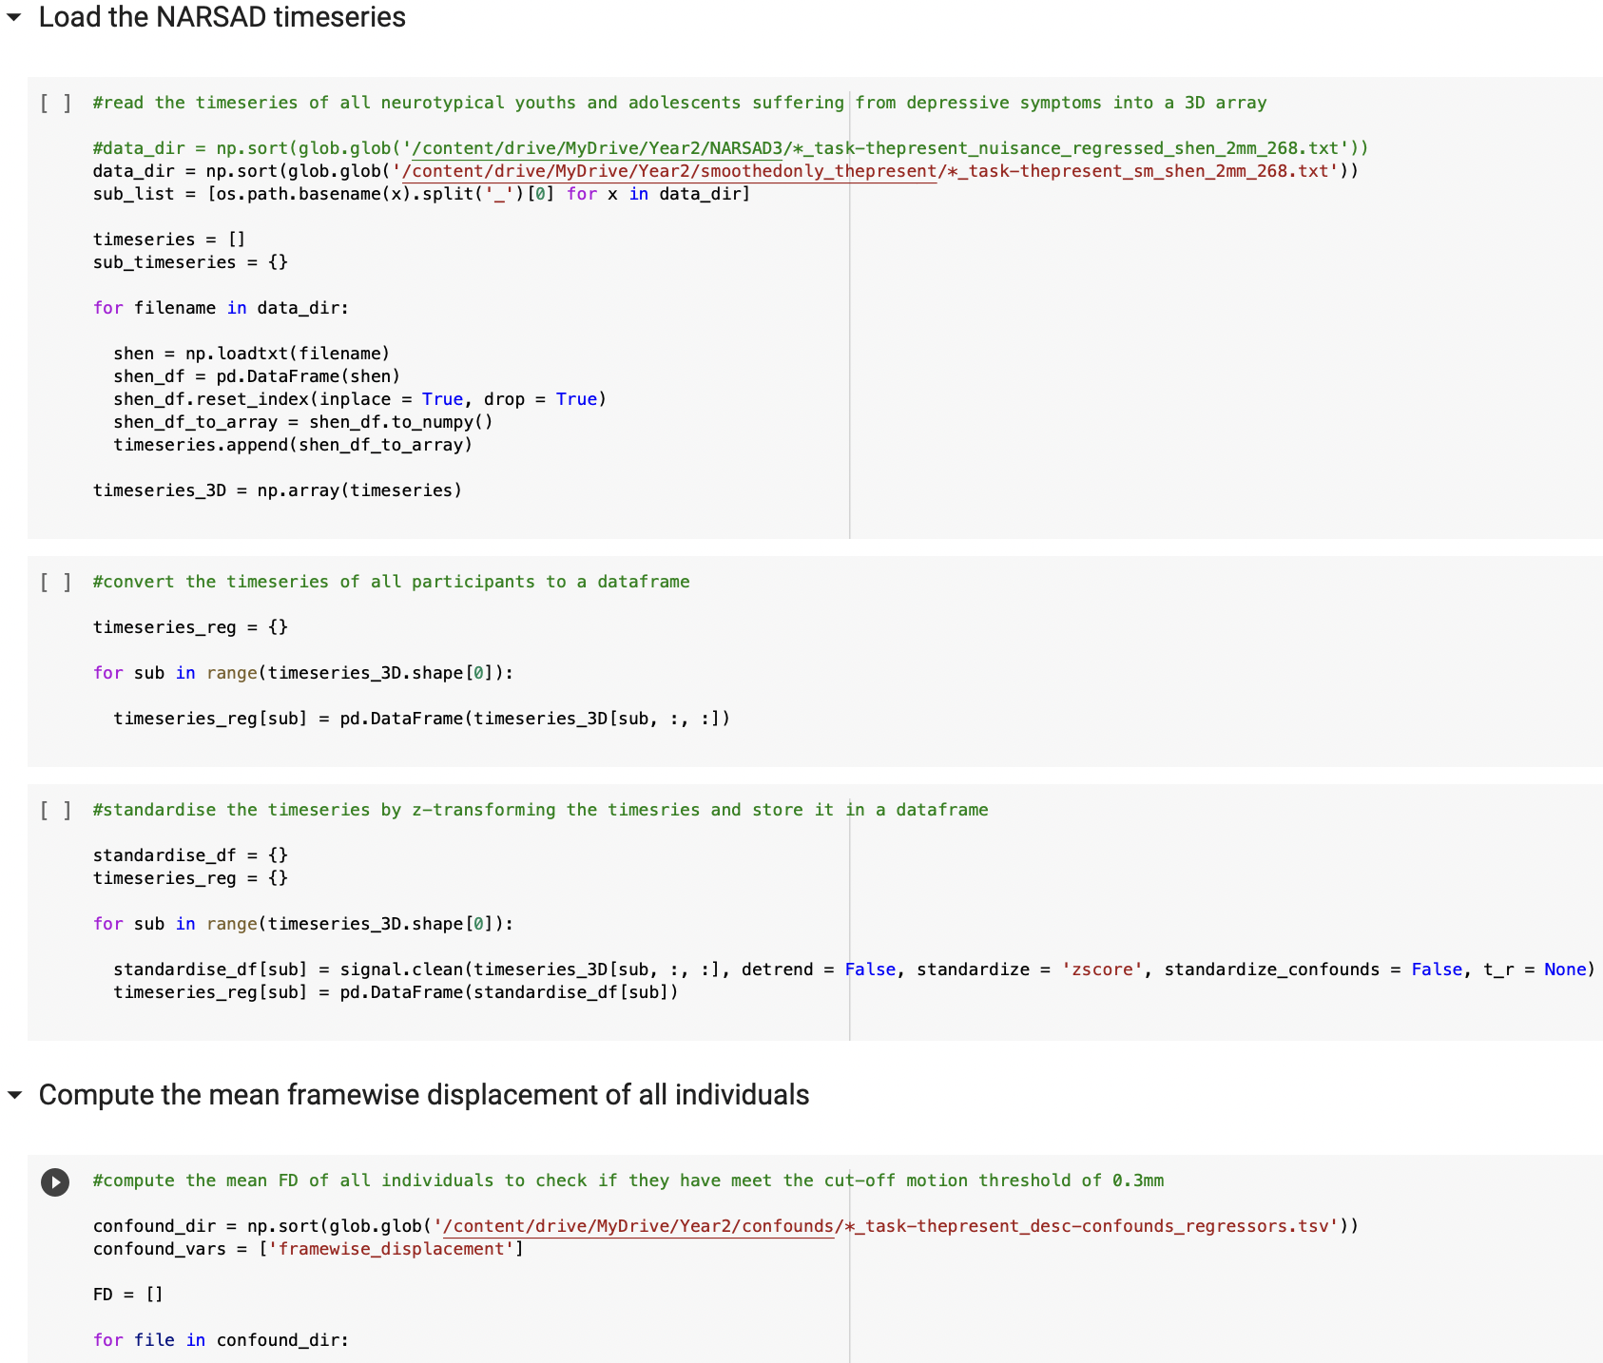
Python Notebooks: Google Colab

Slide 22
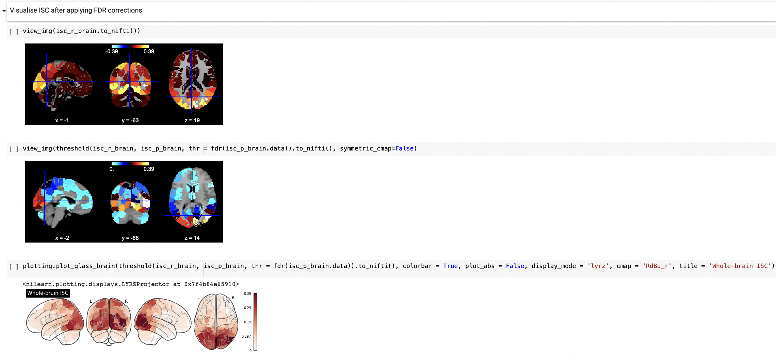
Python Notebooks: Google Colab
Powerful for resting-state fMRI, task-based fMRI and movie-watching fMRI analysis
Limit to 12GB RAM

Slide 23
Python Notebooks
Neuroimaging-based Packages
NumPy: numerical package for scientific and arithmetic computing
Pandas: package to manipulate DataFrame like objects in formats such as excel and csv
Statsmodels: package to build statistical models and perform statistical tests
Scikit-learn: package for machine learning algorithms, model selection, dimensionality reduction and preprocessing such as feature selection
Nilearn: package to perform neuroimaging-based analyses on structural and functional MRI data in addition to applying machine learning techniques on high-dimensional neuroimaging data such as MVPA
Nltools: neuroimaging-based package for fMRI data analyses (e.g., resting-state, task-based, naturalistic)
Pingouin: package which offers simple statistical functions and graphics
Matplotlib: package to facilitate data visualisation in both static and interactive fashions
Seaborn: package to enable data visualisation for statistical measures and tests
*These packages are not exhaustive as there are several more which are equally useful.

Slide 24
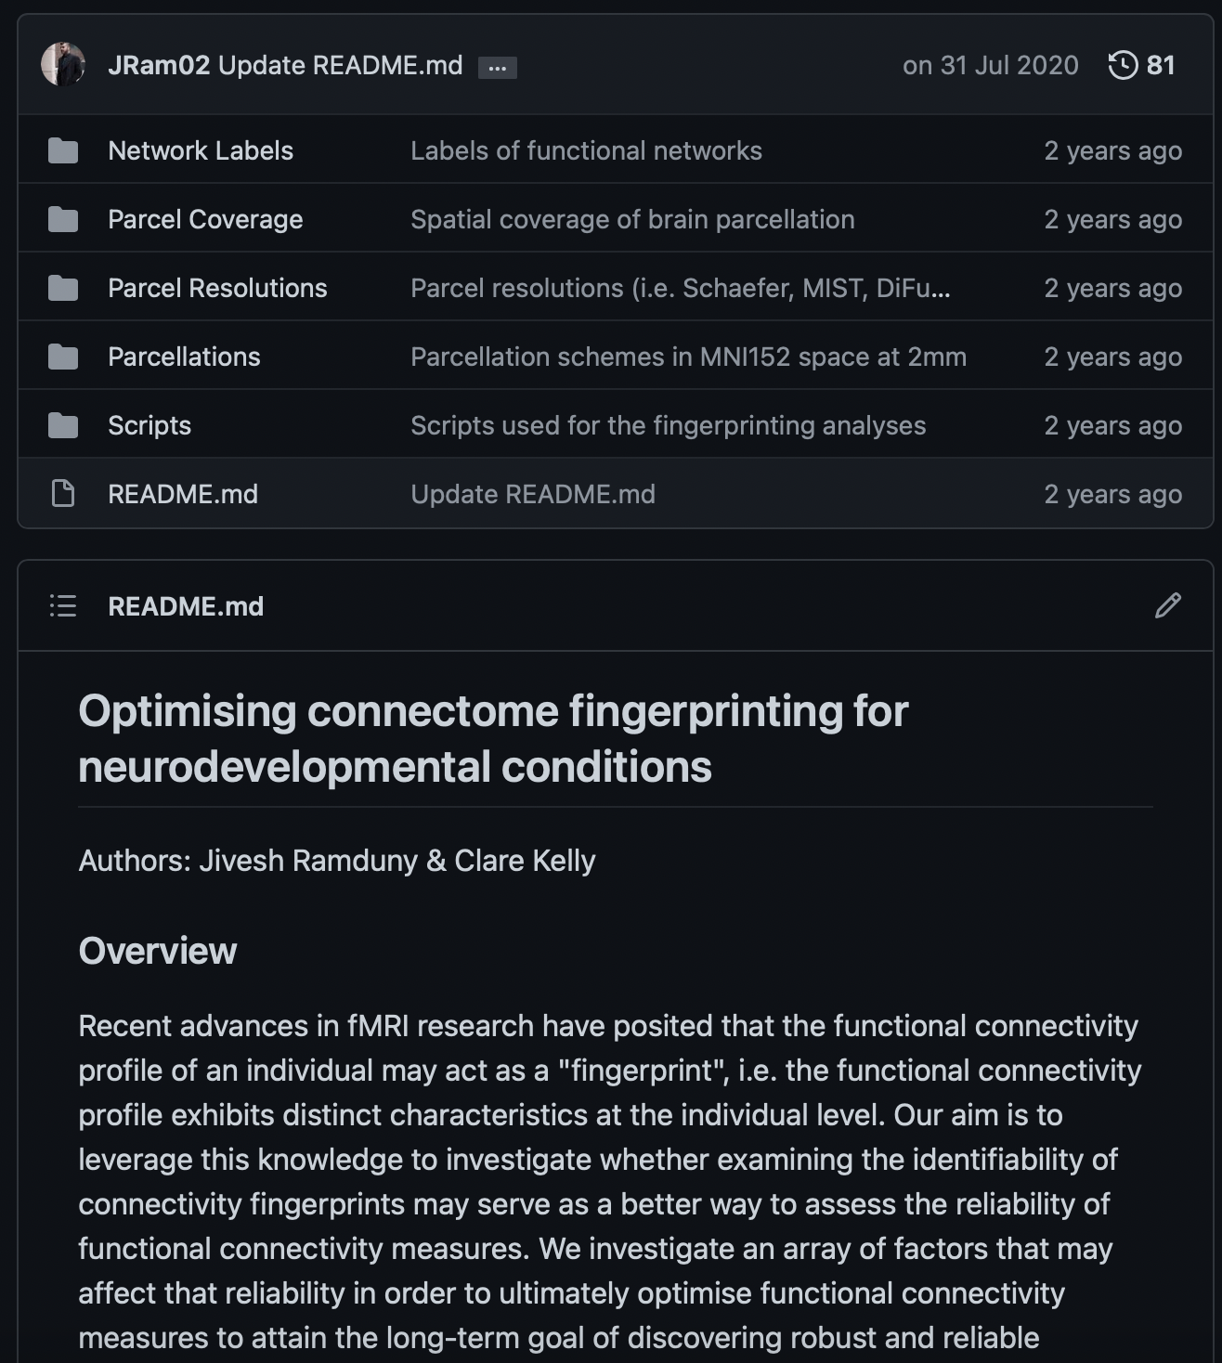
Code Sharing
GitHub Repository

Slide 25
Code Sharing
GitHub Repository

Slide 26
Resistances
It’s only the result that matters!
I’d rather do real science than tidy up my data.
Mind your own business! I document my data the way I want!
Excel works just fine. I don’t need any fancy R or Python or whatever.
Reproducibility sounds alright, but my code and data are spread over so many hard drives and directories.
It would just be too much work to collect them all in one place.
We can always sort out the code and data after submission.
Adapted from Markowetz, 2015

Slide 27
Where Do We Start?
Top-Down vs. Bottom-Up
PI
PI
POSTDOCS
POSTDOCS
PHD STUDENTS
PHD STUDENTS

Slide 28



Jivesh Ramduny IMAGING MIND ARCHITECTURE LAB TRINITY COLLEGE DUBLIN
ramdunyj@tcd.ie
@JRamduny
yourboyjiv
https://immalab.wordpress.com

